Slide 1
Lecture 16

Slide 2
Lecture 16 objectives
Understand and describe common biological macromolecules
Understand and describe how structure relates to function
Understand and describe structure and function of complex macromolecules (containing more than 1 type of macromolecule)

Slide 3
Common biological macromolecules
The (almost) universal macromolecules in nature are:

Slide 4
Carbohydrates
Carbohydrates are:
Common examples:
Monomeric unit:
Polymeric unit:

Slide 5
Carbohydrates
Carbohydrate monomeric units joined by ______ bond.
A. Peptide
B. Glycosidic
C. Phosphodiester
D. Ester

Slide 6
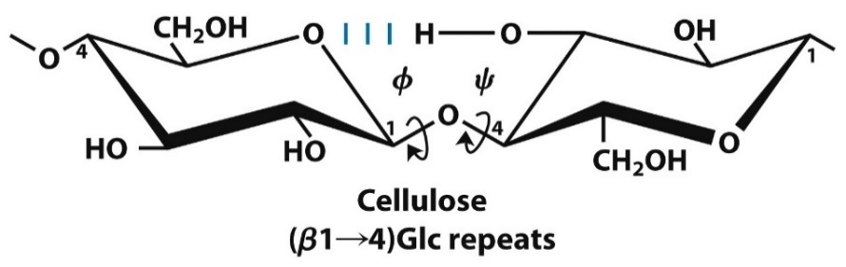

Carbohydrates
Carbohydrates are:
Common examples:
Monomeric unit:
Polymeric unit:

Slide 7
Carbohydrates -- Functions
Carbohydrates functions?

Slide 8

Bond rotation = structure!

Slide 9
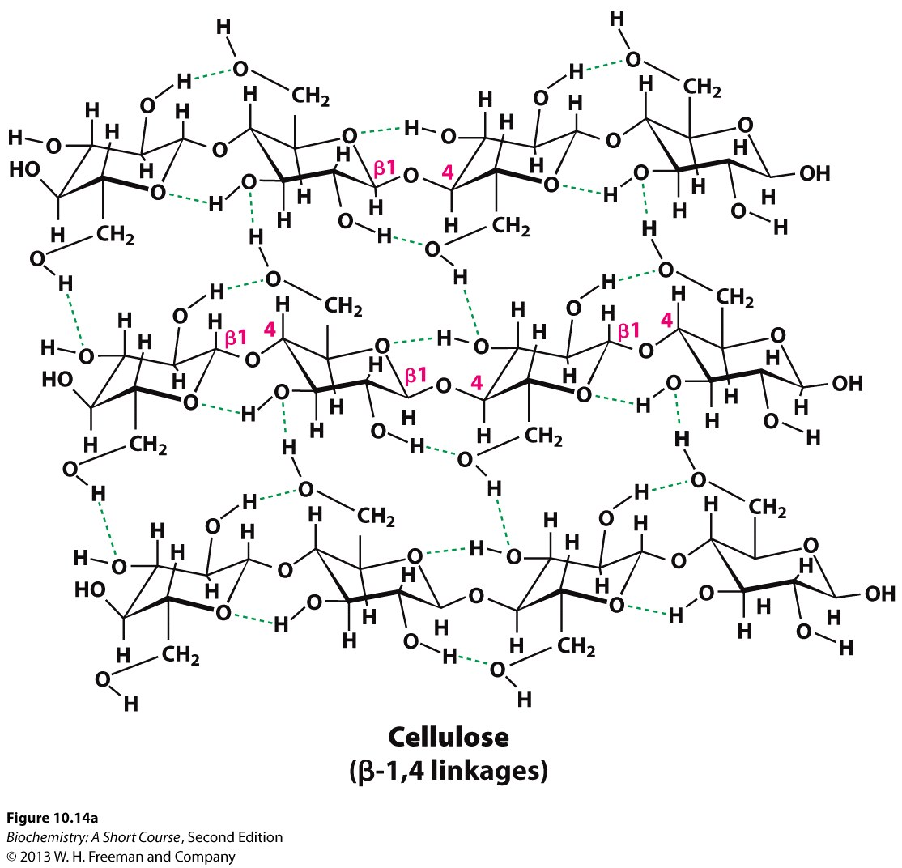
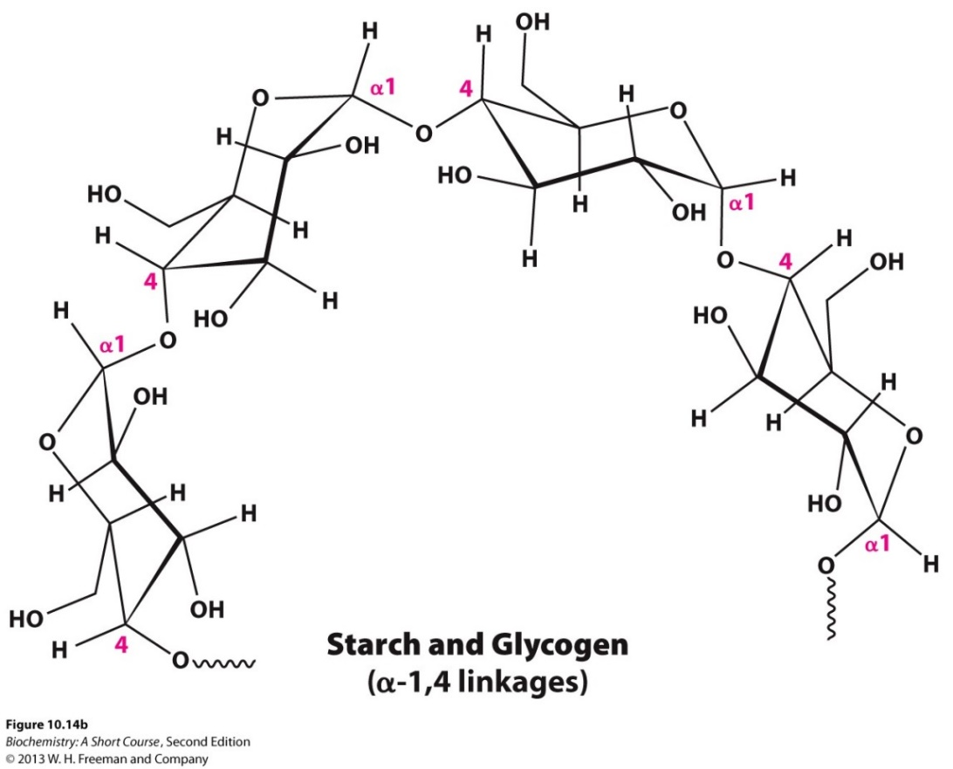
Functions of carbs: Structure, function

Slide 10
Proteins
Proteins are:
Common examples:
Monomeric unit:
NH₃⁺
H
C
COO⁻
R

Slide 11
Proteins
Protein monomeric units joined by ______ bond.
A. Peptide
B. Glycosidic
C. Phosphodiester
D. Ester

Slide 12
Proteins
Proteins are:
Common examples:
Monomeric unit:
NH₃⁺
H
C
COO⁻
R

Slide 13
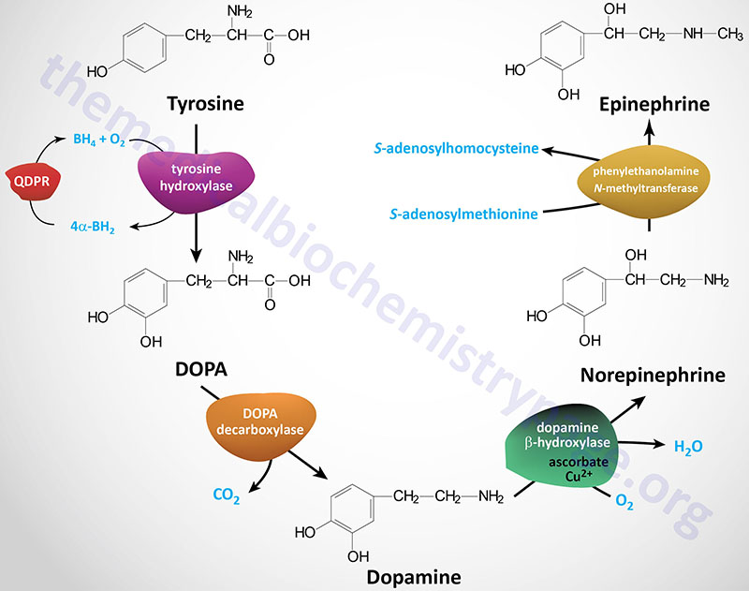
Amino acids
Functions of amino acids
https://themedicalbiochemistrypage.org/aminoacidderivatives.php

Slide 14
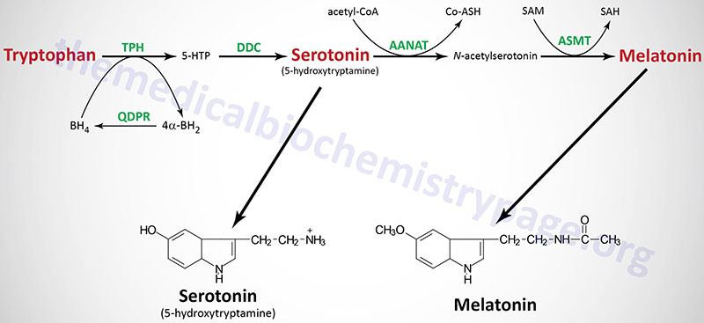
Amino acids
Functions of amino acids
https://themedicalbiochemistrypage.org/aminoacidderivatives.php

Slide 15
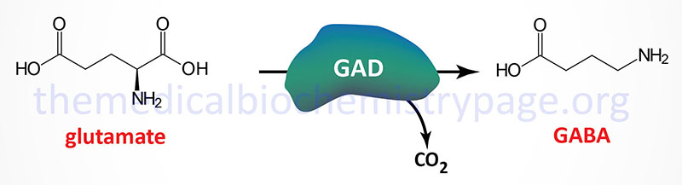
Amino acids
Functions of amino acids
https://themedicalbiochemistrypage.org/aminoacidderivatives.php

Slide 16
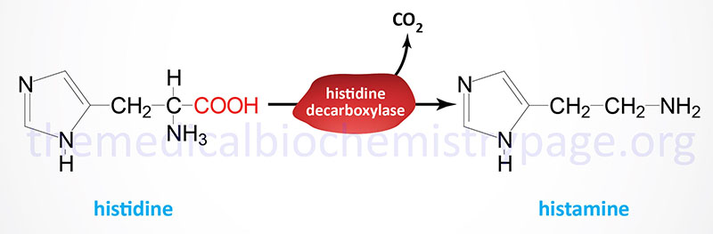
Amino acids
Functions of amino acids
https://themedicalbiochemistrypage.org/aminoacidderivatives.php

Slide 17
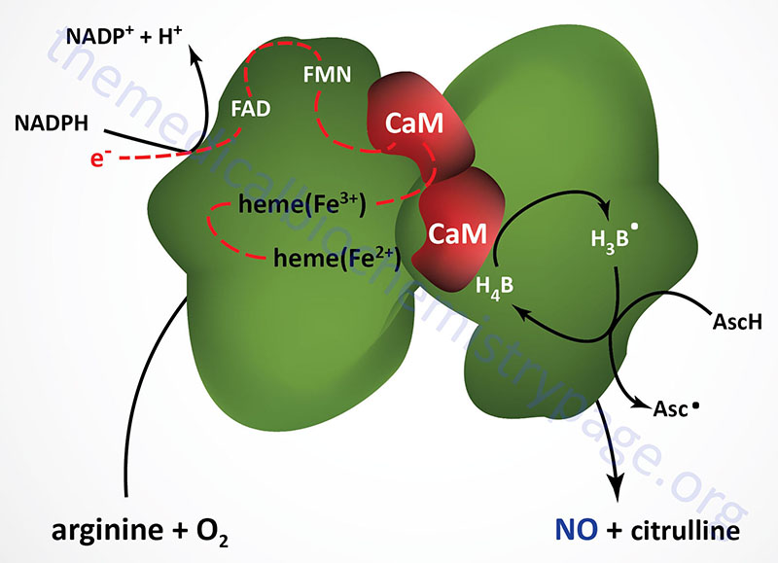
Amino acids
Functions of amino acids
https://themedicalbiochemistrypage.org/aminoacidderivatives.php

Slide 18
Proteins
Rate of breakdown of two different proteins is shown in the brain and muscle. Based on these data, what is your best explanation?
“Blue” protein. pI = 7.4
*
“Green” protein. pI = 3.1
* Is p<0.01
Rate of protein breakdown
Brain
Muscle

Slide 19
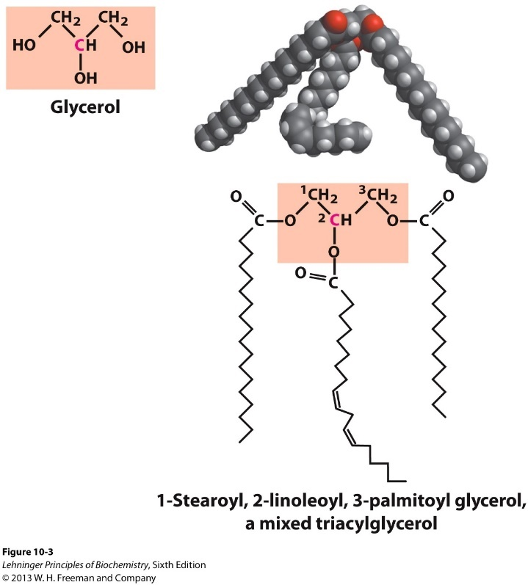
Lipids
Lipids are:
Common examples:
Monomeric unit:
Polymeric unit:

Slide 20
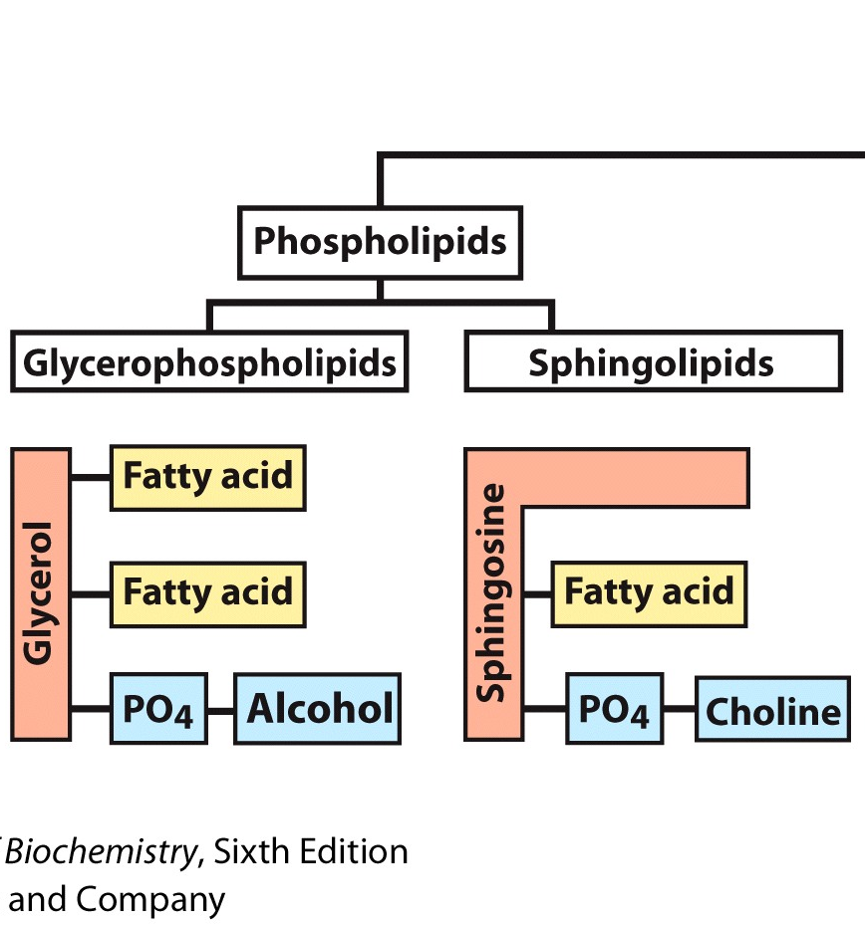
Lipid -- Functions
Lipids functions?

Slide 21
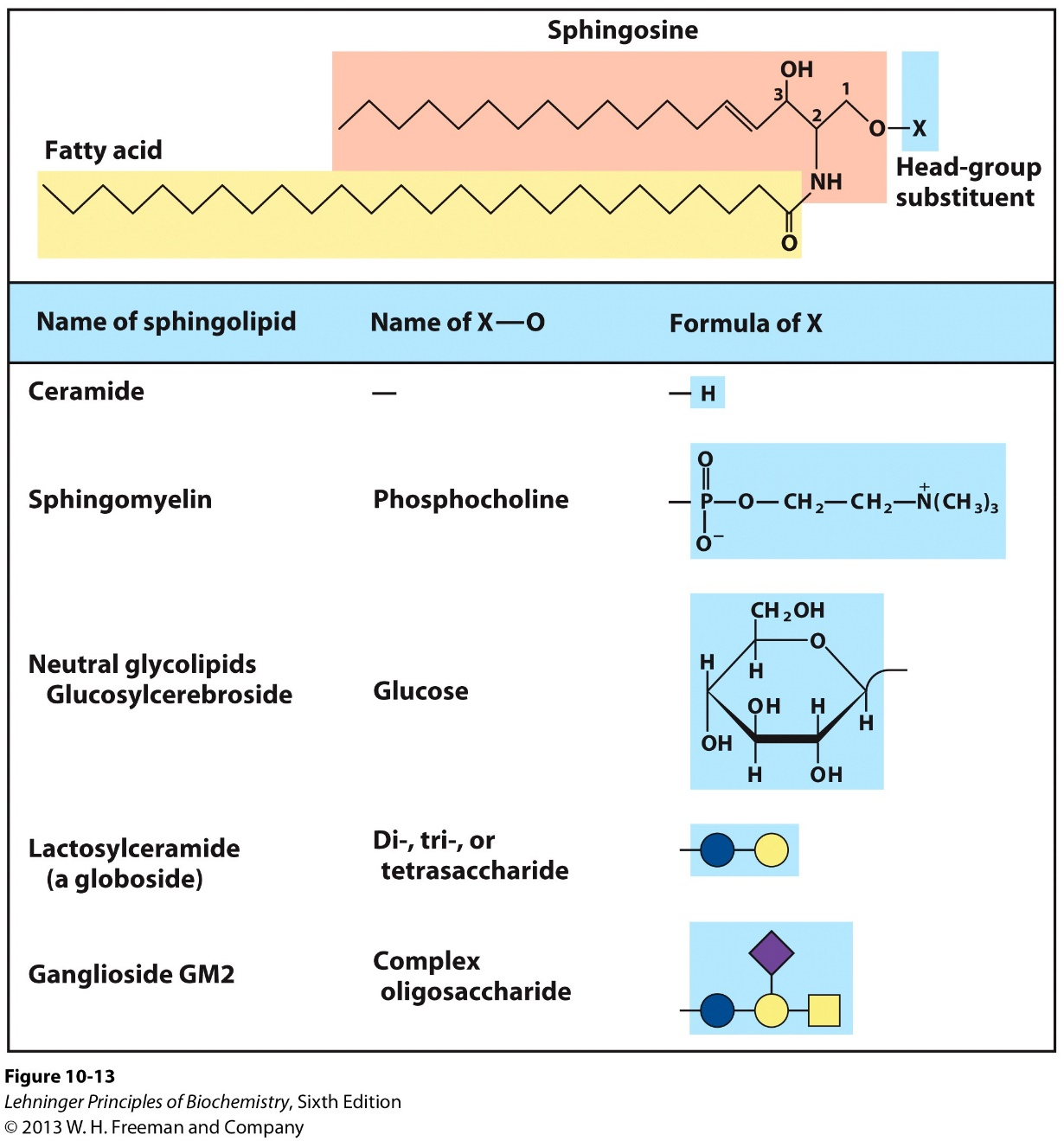
Lipid -- Functions

Slide 22
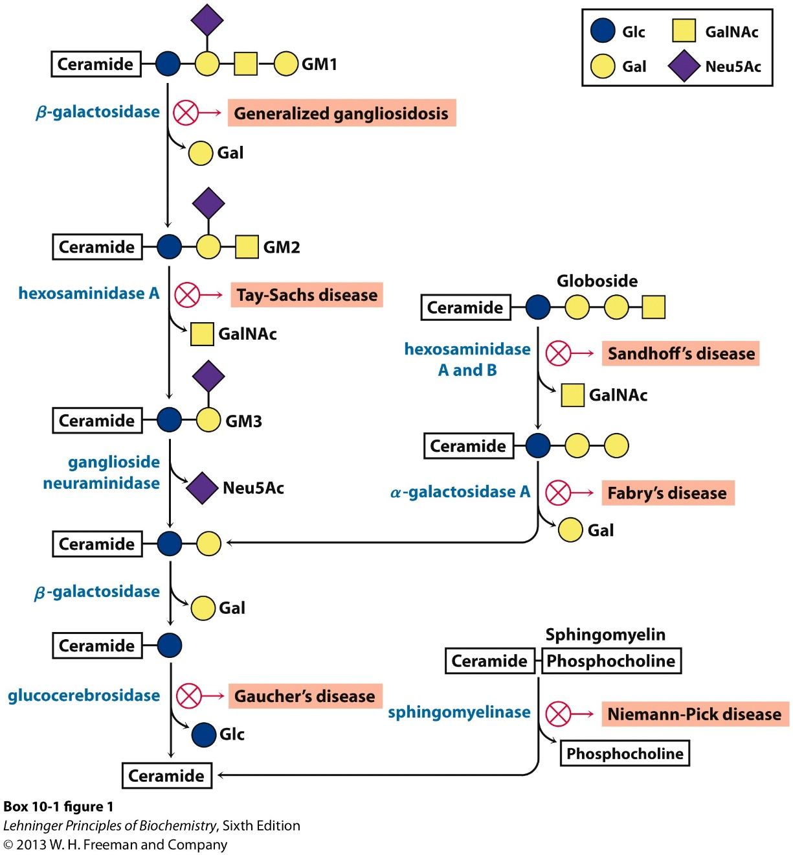
Lysosomal storage disorders

Slide 23
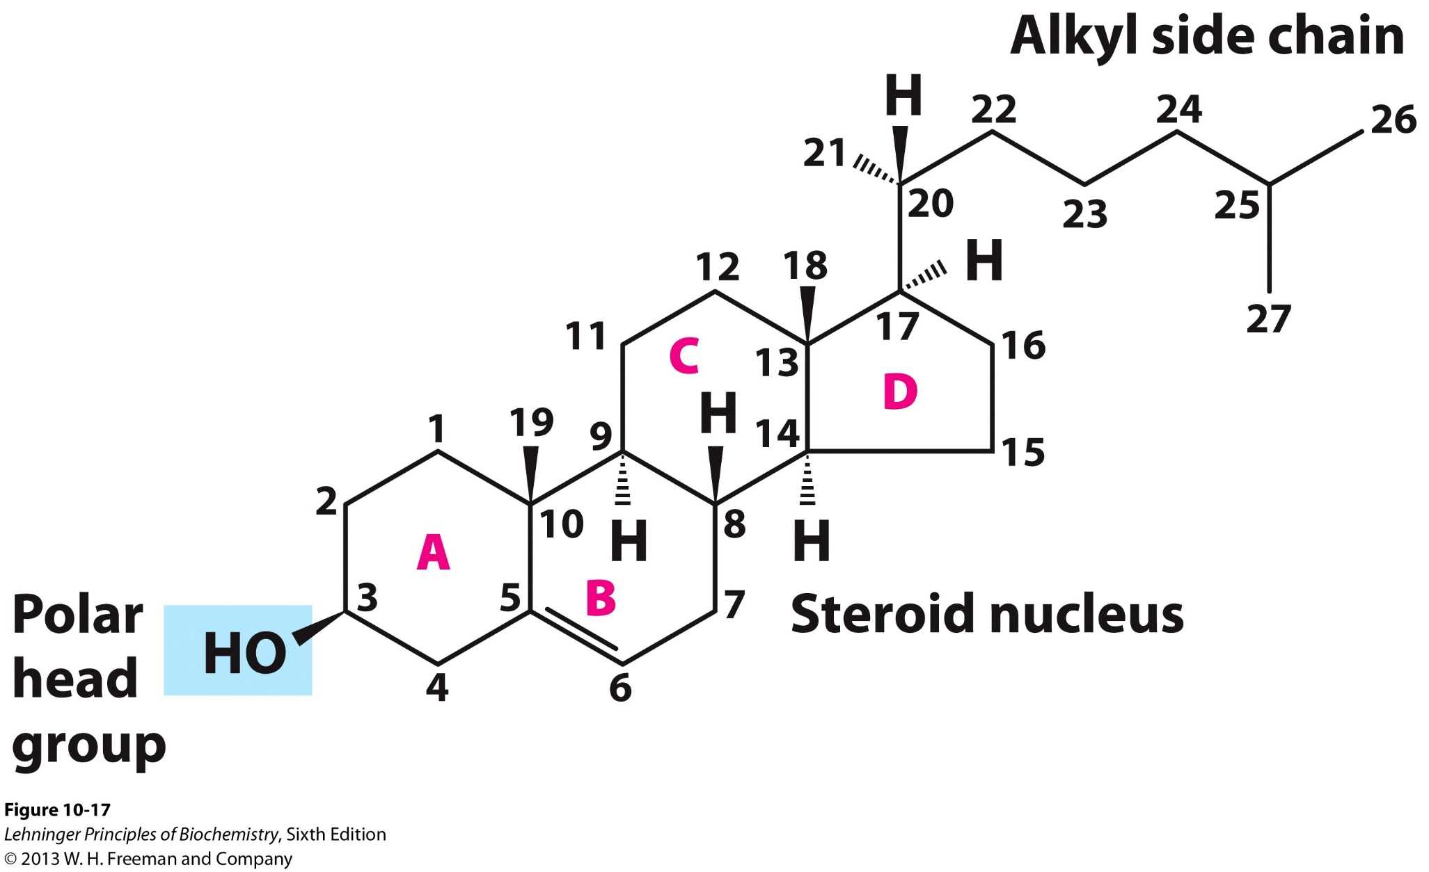
Lipid functions -- Sterols

Slide 24
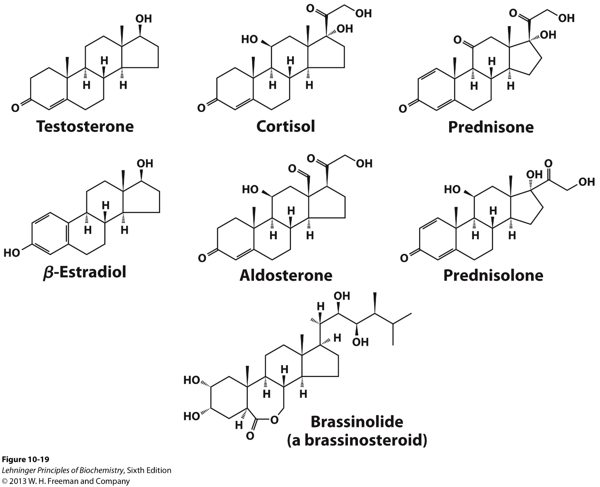
Lipid functions -- Sterols

Slide 25
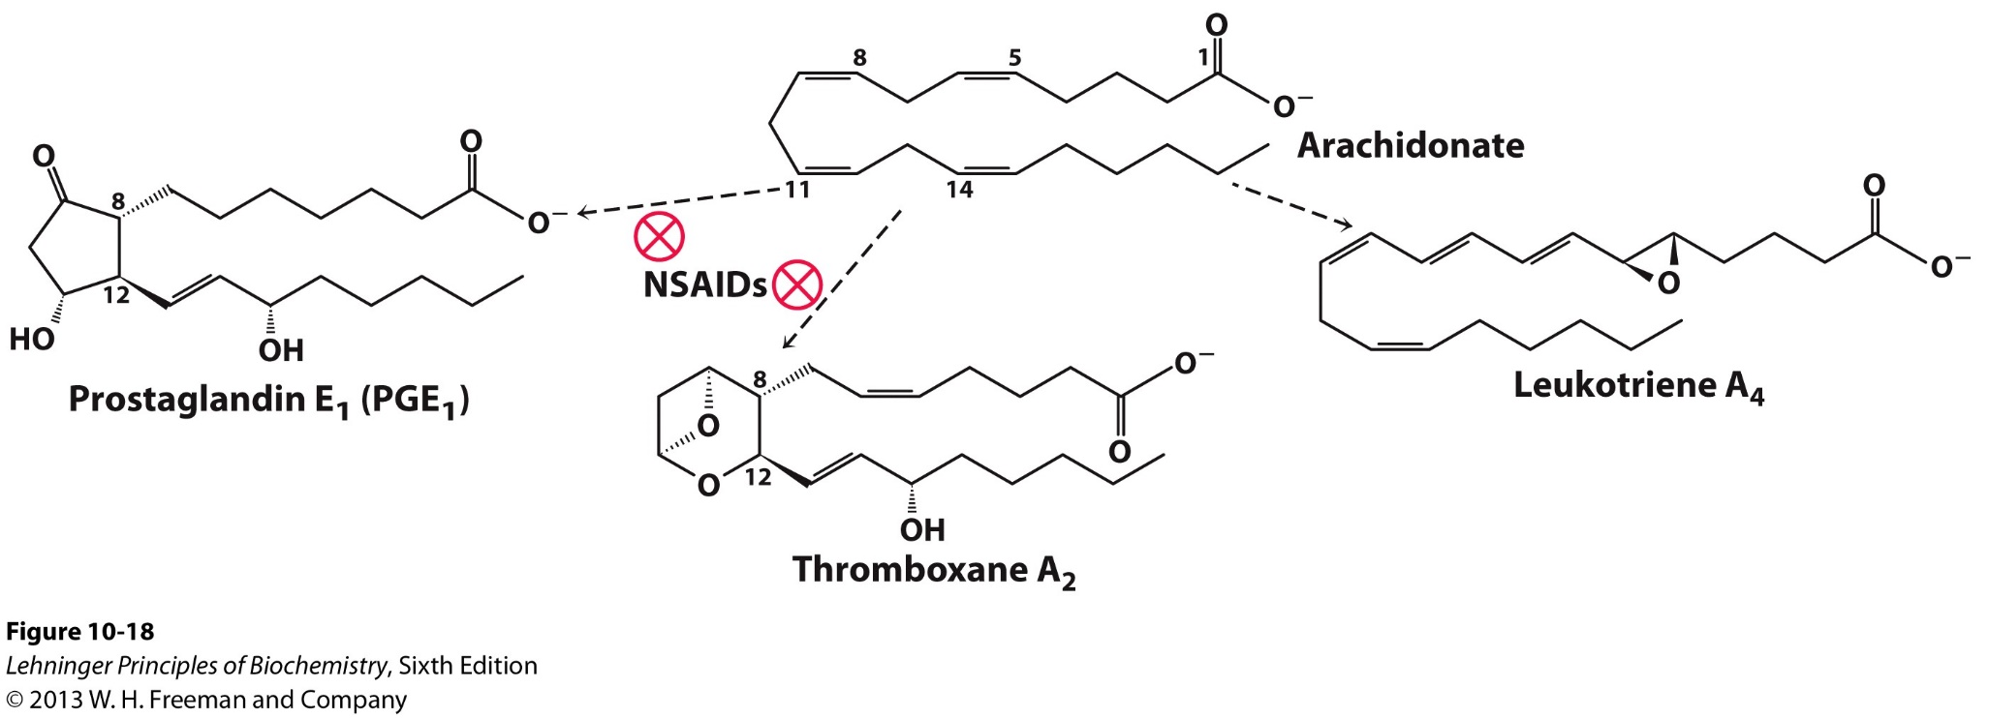
Lipid functions -- Signaling molecules

Slide 26
Lipid functions

